Slide 1
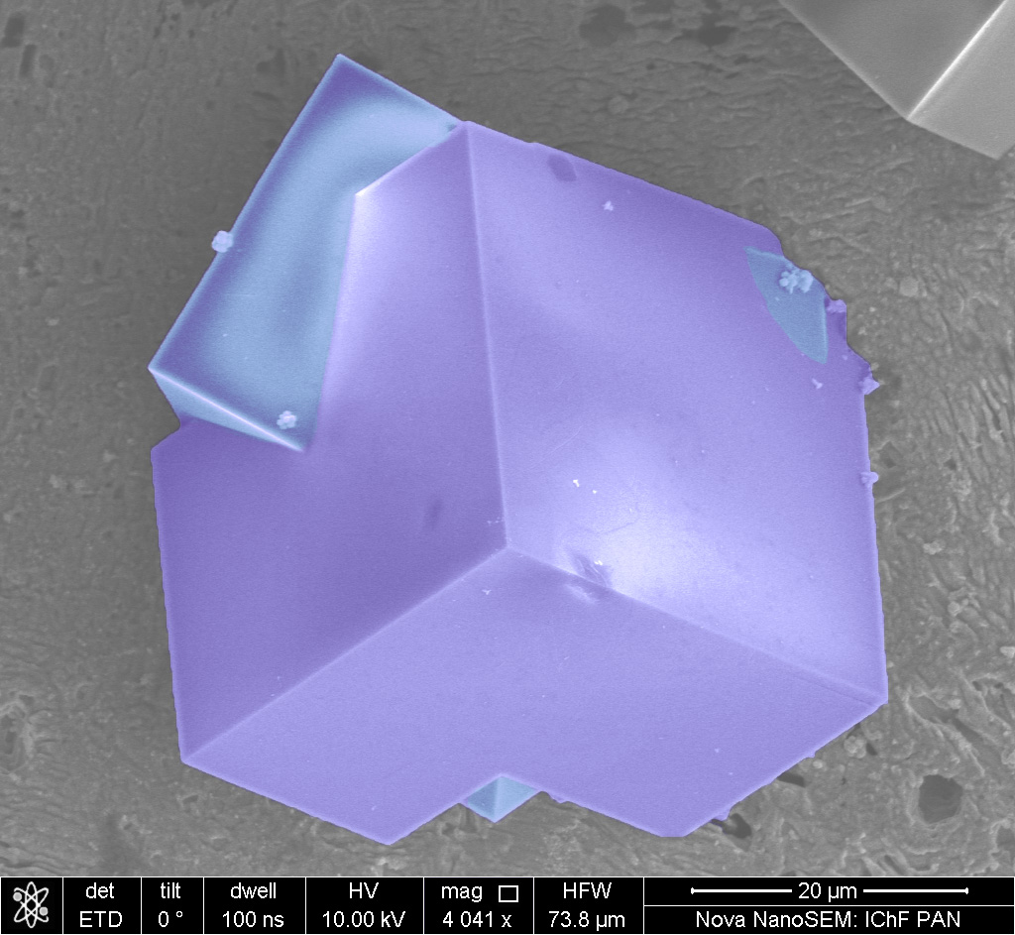
Microscopic Methods for Chemists
– with an emphasis on SEM
Martin Jönsson-Niedziółka
martinj@ichf.edu.pl
Bluesky: @jonsson-niedziolka.pl
Charge Transfer Processes in Hydrodynamic systems

Slide 2
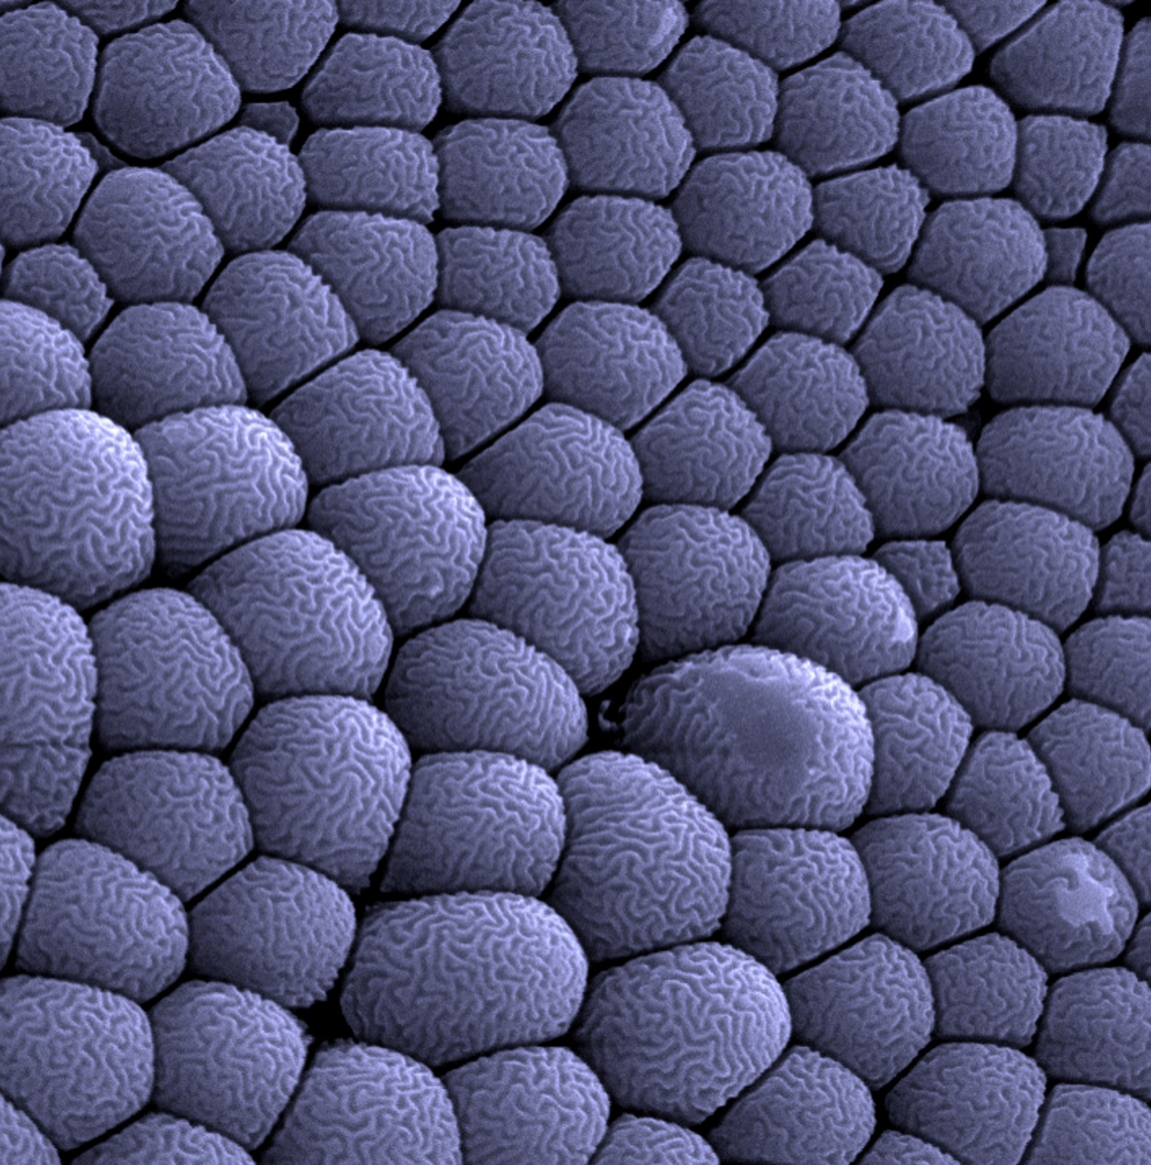
Practical Information
Content
How everything started…basics and background
Optical microscopy towards nanoscopy
Scanning probe microscopy
Electron microscopy – principles, electron-material interaction
What affects SEM and how to obtain good a good image
SEM vs. TEM
EDX
Our system & practical notes
Practical SEM session (4h)
7 lectures
4-hour practical (groups of 3)
Exam: Measure “mystery sample”
Analyse images (size, composition)
Hand in report
Info on www.charge-transfer.pl/sem-course

Slide 3
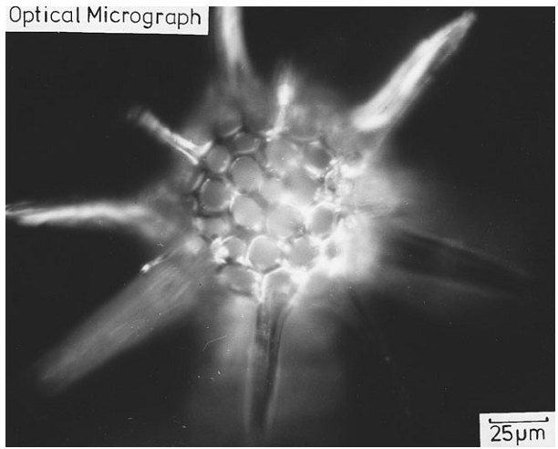
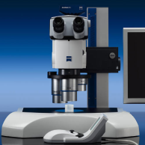
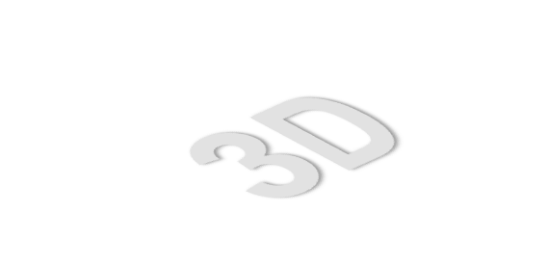
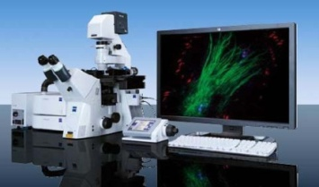
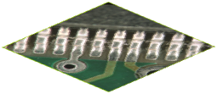
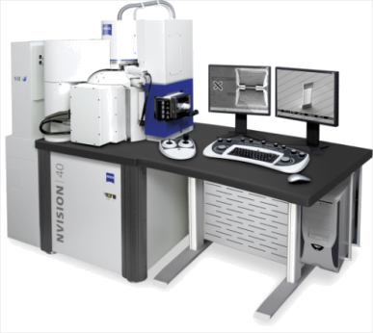
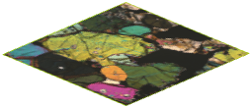
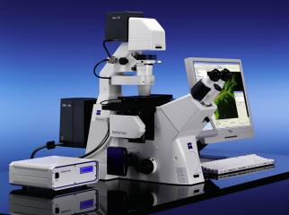

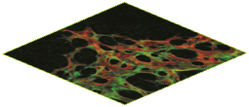
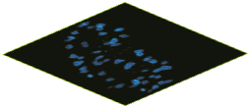
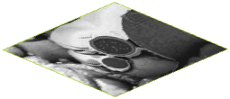
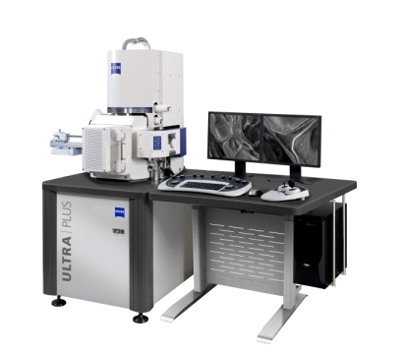
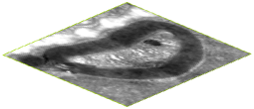
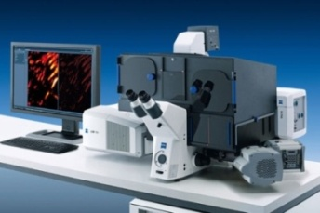
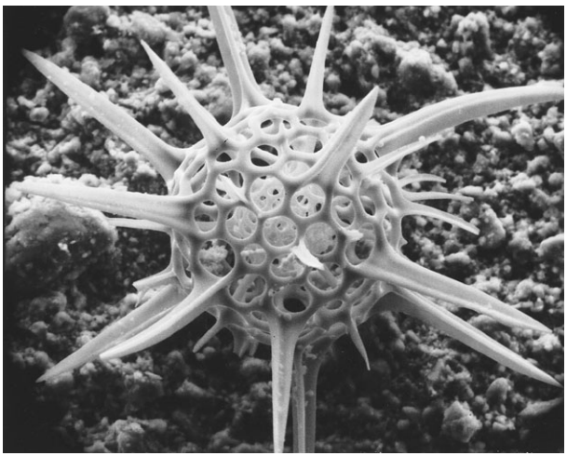
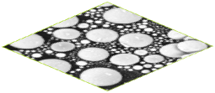
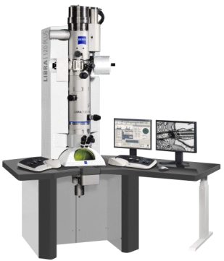
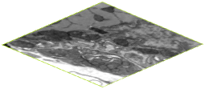
Overview
Optical Micrograph
5 µm
  Stereo
1 µm
  Confocal
500 nm
50 nm
5 nm
  Focused Ion Beam
  Widefield
1 nm
0.5 nm
Electron Micrograph
0.1 nm
  Superresolution
  Scanning Electron
  Scanning He-Ion
  Transmission Electron
Optical and SEM micrograph of the
radiolarian Trochodiscus longispinus

Slide 4
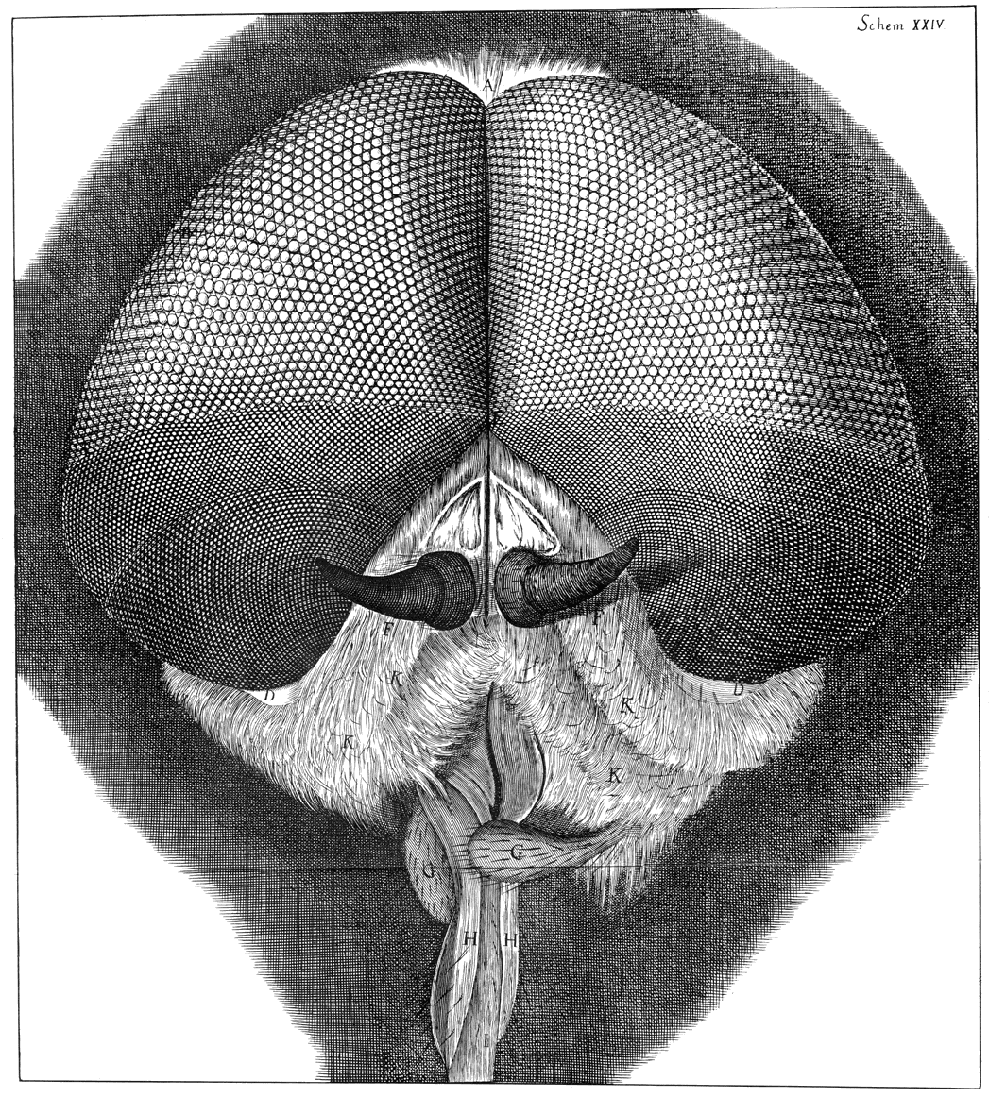
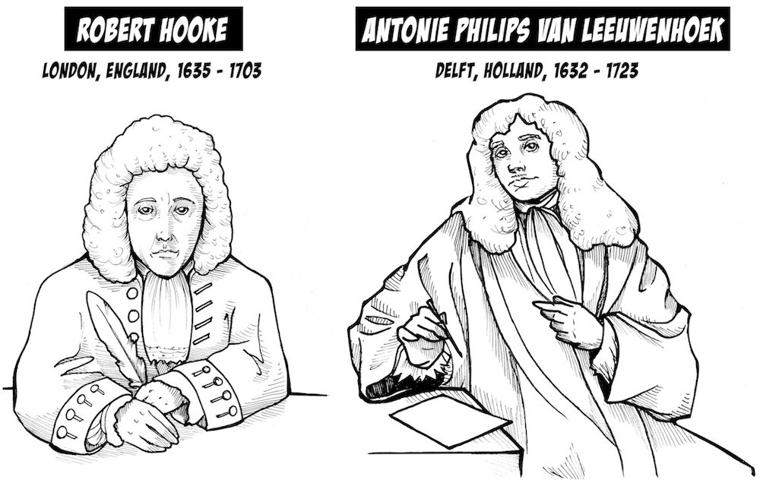
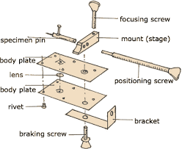
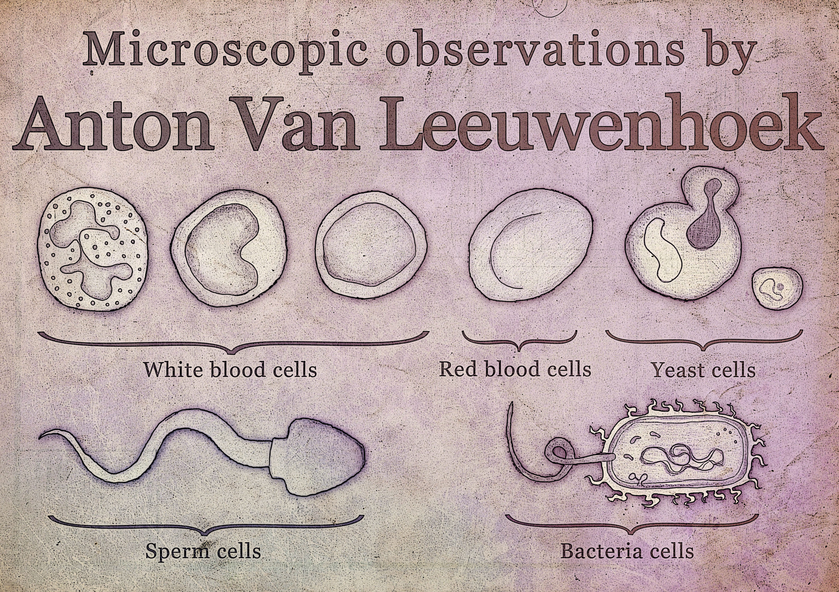
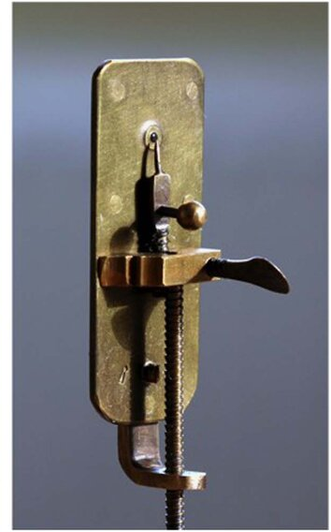
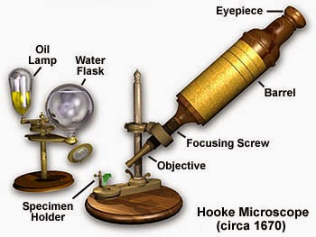
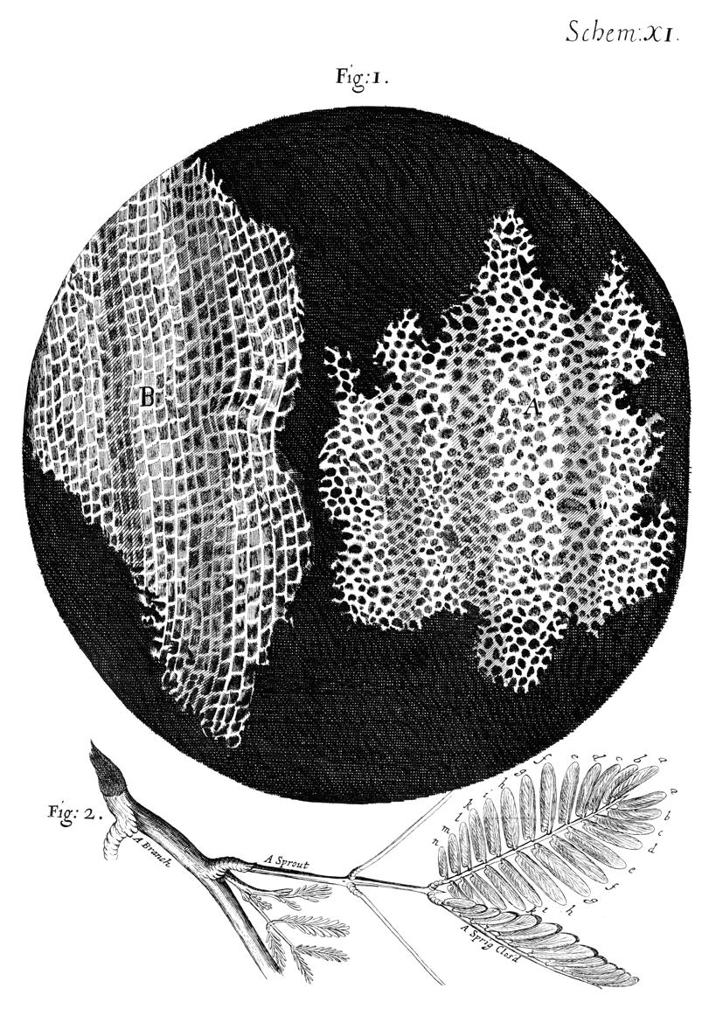
First Pioneers of Microscopy
1670s

Slide 5
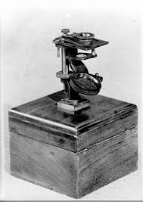
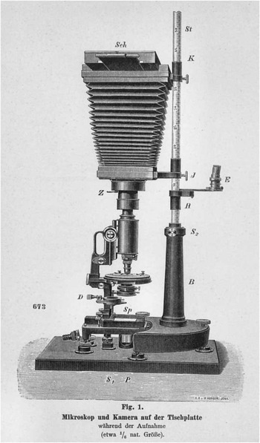
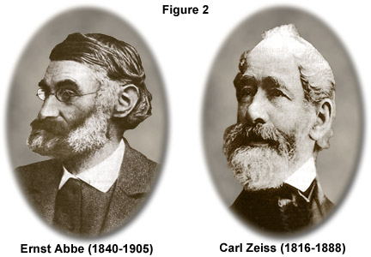
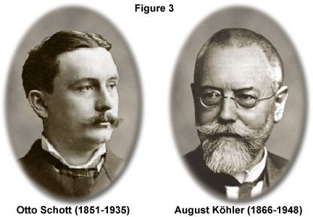
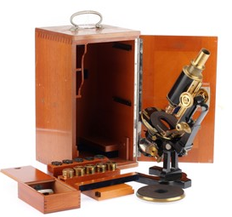
First Pioneers of Microscopy
1850s
first microscopes
1860s
theory of microscopy
1880s
Optical-grade glass
1890s
Optimised illumination

Slide 6

Nature of Microscopy
Optics
Ray – Waves - Particles
(geometrical optics) (physical optics)
Refraction
Reflection
Diffraction
Polarisation
Interference

Slide 7
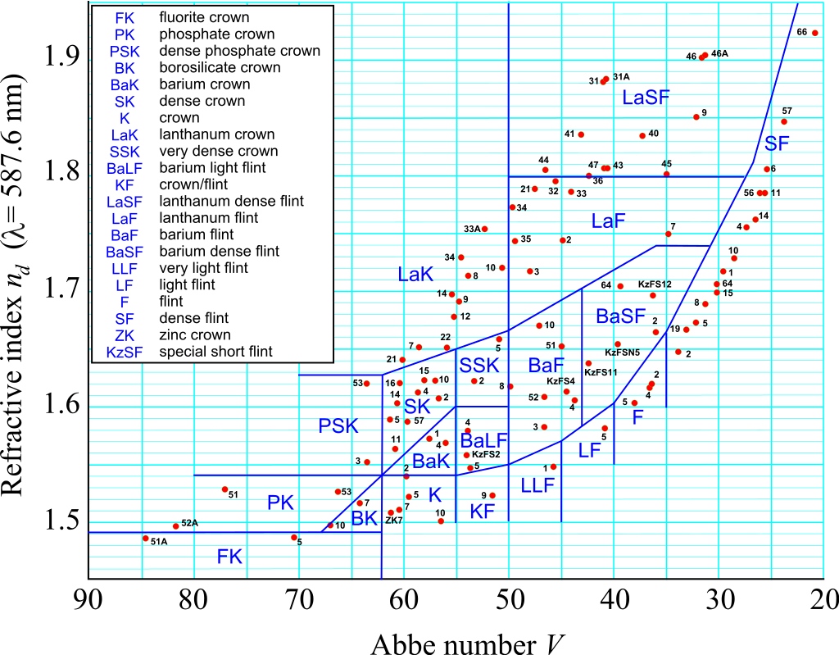
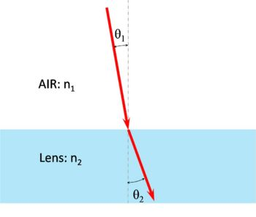
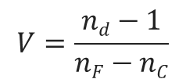
Nature of Microscopy
Optics
Ray
(geometrical optics)
glass ≠ glass
Refraction
Reflection
$$V=\frac{nd−1}{nF−nC}$$
n_{d,F,C} = refractive index of the material for wavelengths 587.56 nm, 656.3 nm, 486.1 nm

Slide 8
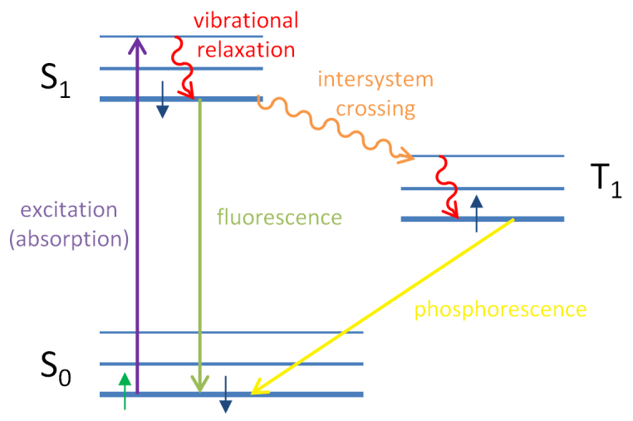
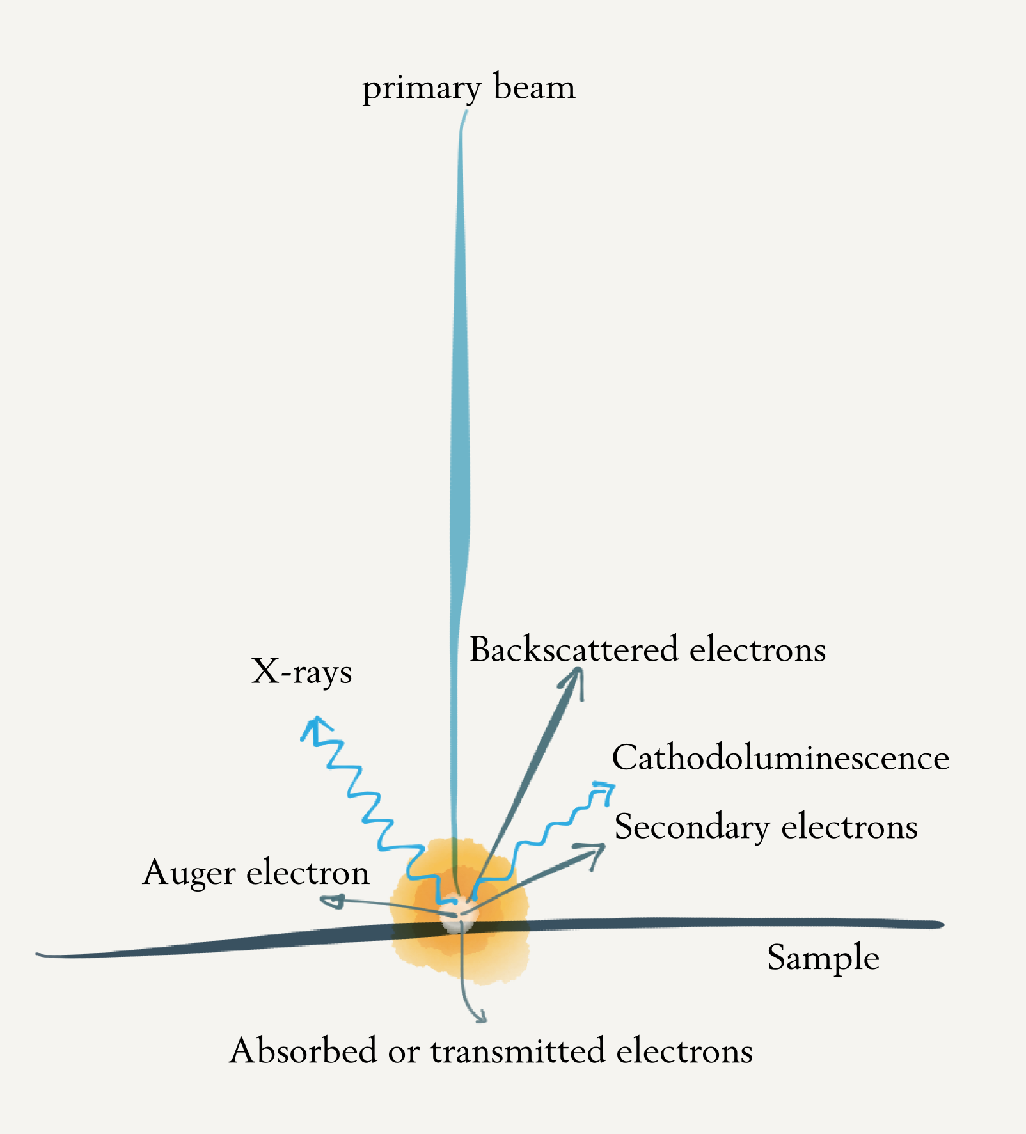
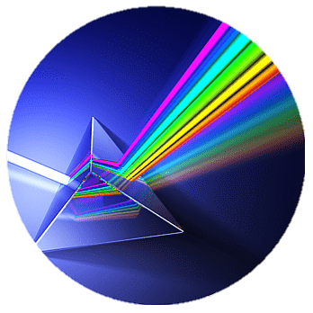
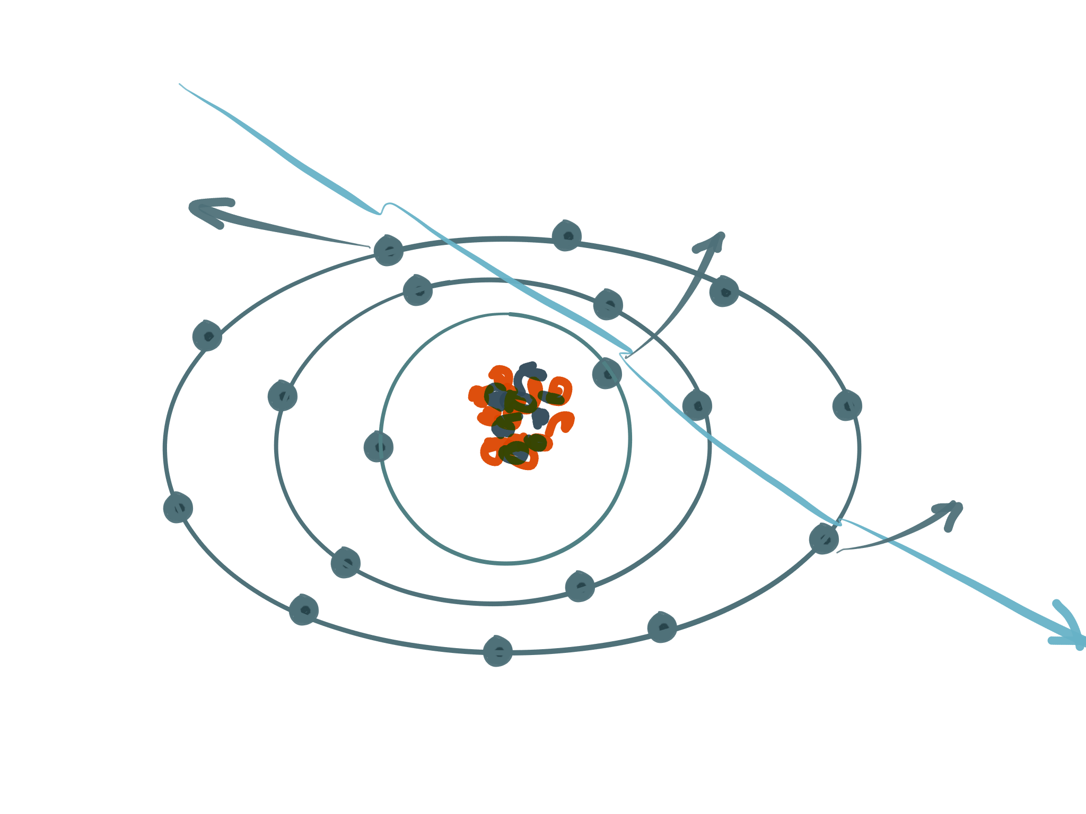
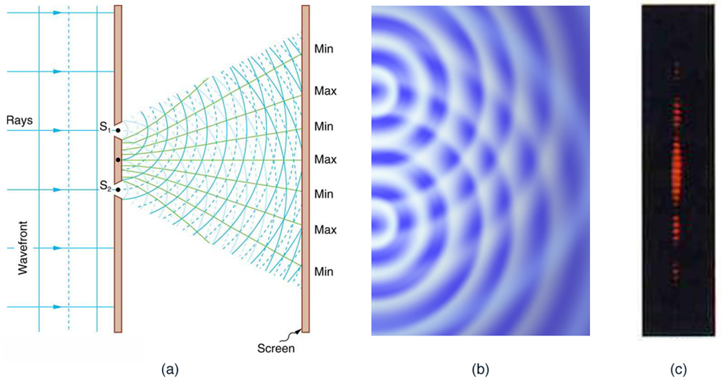
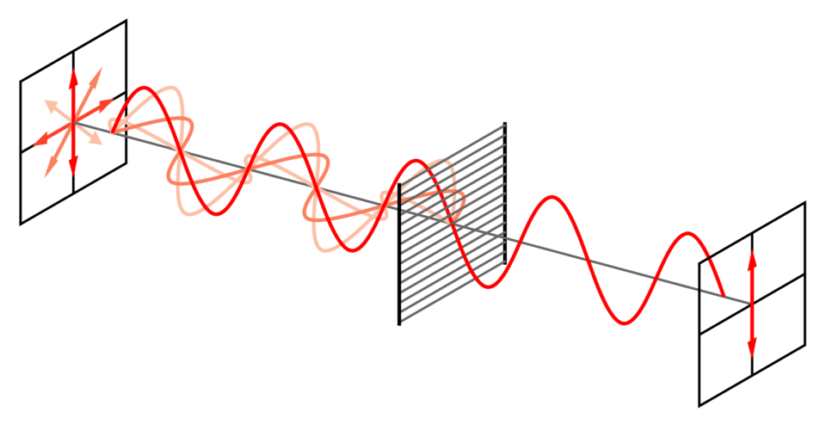
Nature of Microscopy
Optics
Ray – Waves - Particles
(geometrical optics) (physical optics)
More on this later…
Diffraction
Polarisation
Interference

Slide 9
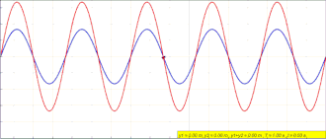
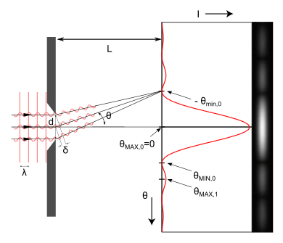
Abbe said:
“The microscope image is an interference effect of a diffraction phenomenon.”
And Richard Feynman said:
“No-one has ever been able to define the difference between interference and diffraction satisfactorily. It is just a question of usage, and there is no specific, important physical difference between them. The best we can do, roughly speaking, is to say that when there are only a few sources, say two, interfering, then the result is usually called interference, but if there is a large number of them, it seems that the word diffraction is more often used.”

Slide 10
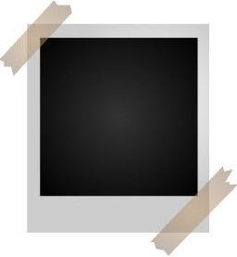
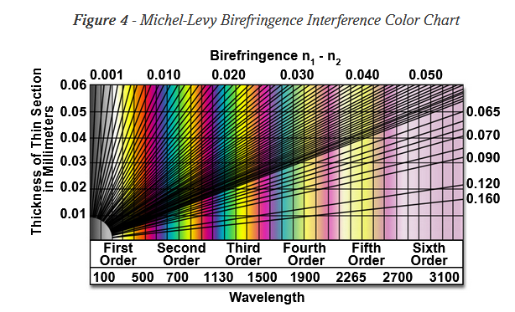
Polarisation
Polarizers
Reflective polarizers, e.g. parallel wire grid polarizers (parallel light is reflected, while perpendicular polarized light is transmitted).
Dichroic polarizers e.g nanoparticle polarizers (absorb a specific polarization of light).
Birefringent polarizers (filtered by different refractive index of the polarization of light).
Unpolarized light rapidly varying random combination of p- and s-polarized light.
Ideal linear polarizer I=I/2 (just p- or s-polarized light)
Birefringent materials are optically anisotropic and the refractive index of such materials depends on the direction in which light propagates through it. Birefringence means a ray of unpolarized light is divided into two rays by refraction when passing through the material. Birefringent materials have a highly ordered molecular structure.
Tiny crystallites of iodoquinine sulfate, oriented in the same direction, are embedded in a transparent polymeric film to prevent migration and reorientation of the crystals. Land developed sheets containing polarizing films that were marketed under the trade name of Polaroid®, which has become the accepted generic term for these sheets.
Malus’ law describes transmitted intensity I by
I=I₀cos2θ
With
θ = angle between the incident linear polarization and the polarization axis
I₀ = intensity of linear polarized light

Slide 11
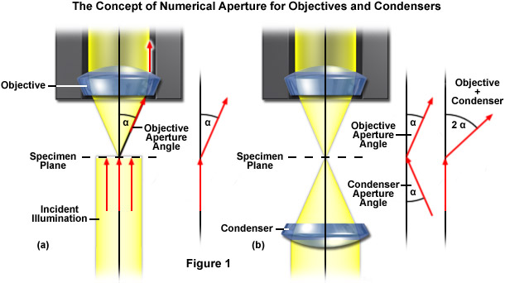
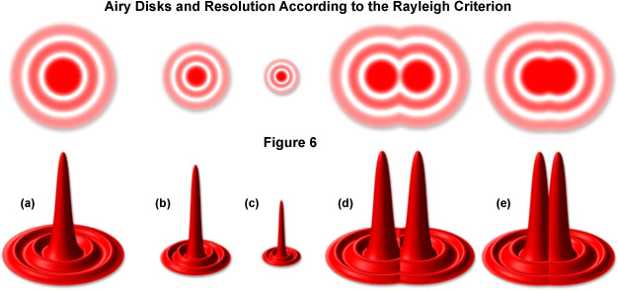
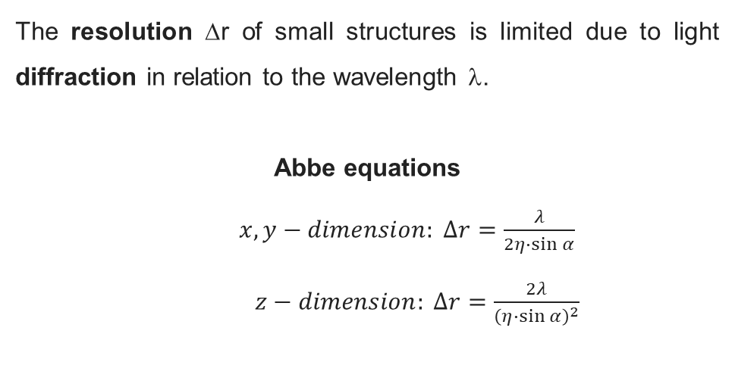

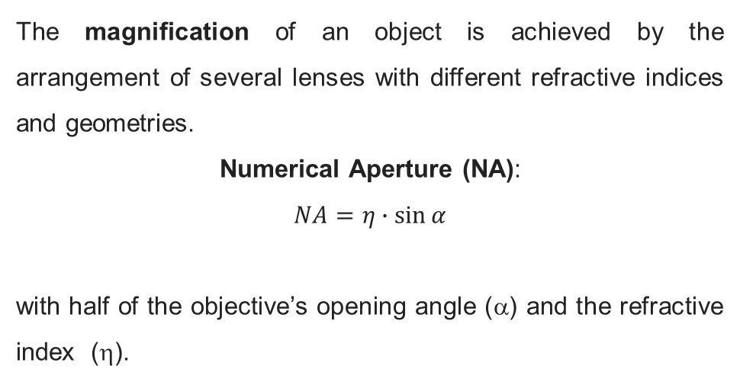
The magnification of an object is achieved by the arrangement of several lenses with different refractive indices and geometries.
Numerical Aperture (NA):
$$NA=η∙\sin{α}$$
with half of the objective’s opening angle (α) and the refractive index (η).
The resolution Δr of small structures is limited due to light diffraction in relation to the wavelength λ.
Abbe equations
$x,y−dimension: ∆r=\frac{λ}{2η∙\sin{α}}$
$z−dimension: ∆r=\frac{2λ}{{\left(η∙\sin{α}\right)}^{2}}$
magnification ≠ resolution
$$dresolved=1.22 ∆r$$
2D → Airy disc
3D → point-spread function

Slide 12
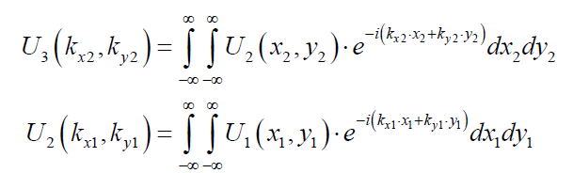
Fourier optics to describe coherent image formation, imaging obtained by illuminating the specimen with spatially coherent light.
U₃ is the Fourier-transformed representation of U₂, which is that of U₁!
with:
Magnification
This ratio can be made arbitrarily large!

Slide 13
The magnification of an object is achieved by the arrangement of several lenses with different refractive indices and geometries.
Numerical Aperture (NA):
$$NA=η∙\sin{α}$$
with half of the objective’s opening angle (α) and the refractive index (η).
The resolution Δr of small structures is limited due to light diffraction in relation to the wavelength λ.
Abbe equations
$x,y−dimension: ∆r=\frac{λ}{2η∙\sin{α}}$
$z−dimension: ∆r=\frac{2λ}{{\left(η∙\sin{α}\right)}^{2}}$
magnification ≠ resolution
$$dresolved=1.22 ∆r$$
2D → Airy disc
3D → point-spread function

Slide 14

Contact:
Martin Jönsson-Niedziółka
email: martinj@ichf.edu.pl
Bluesky: @jonsson-niedziolka.pl

