Slide 1
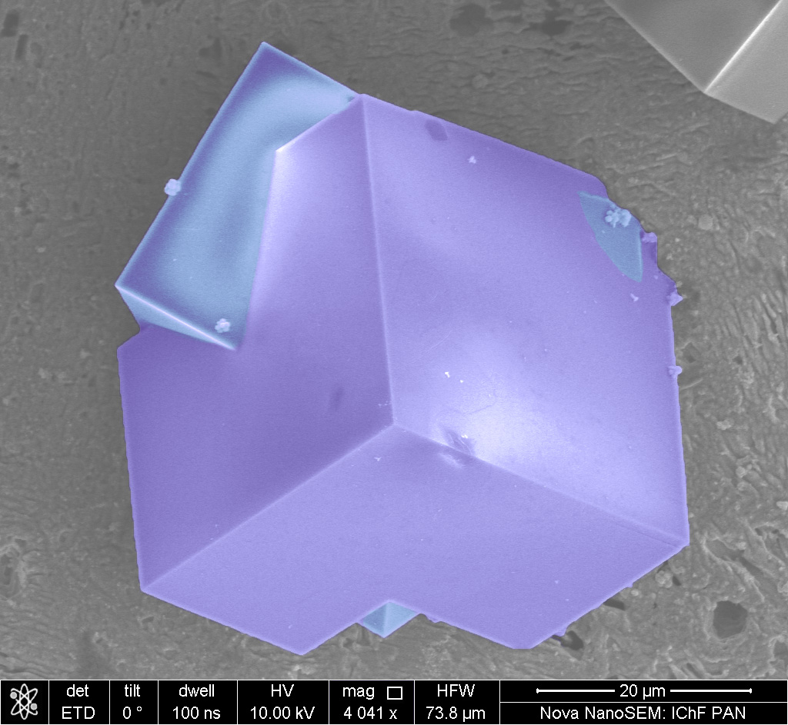
Microscopic Methods for Chemists
– with an emphasis on SEM
Martin Jönsson-Niedziółka
martinj@ichf.edu.pl
twitter: @DrMartinJN
Charge Transfer Processes in Hydrodynamic systems

Slide 2
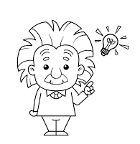
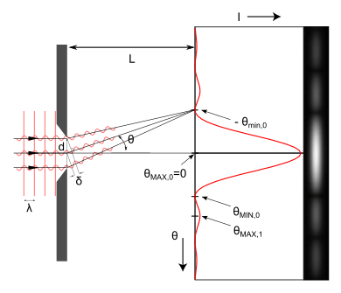
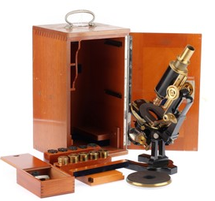
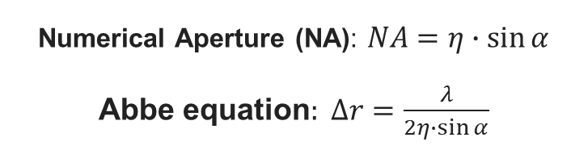
Optics
The story so far …
Ray – Waves - Particles
(geometrical optics) (physical optics)
Reflection
Refraction
Diffraction
Polarisation
Interference
Numerical Aperture (NA): $NA=η∙\sin{α}$
Abbe equation$: ∆r=\frac{λ}{2η∙\sin{α}}$
magnification ≠ resolution
Polarizers [Reflective/Dichroic/Birefringent]
Unpolarized light p- and s-polarized light
Ideal linear polarizer I=I/2 (just p- or s-polarized light)
From this…
Notes:
Somewhat chaotic introduction to some concepts of optics.

Slide 3
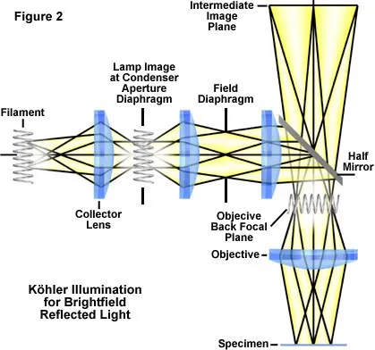
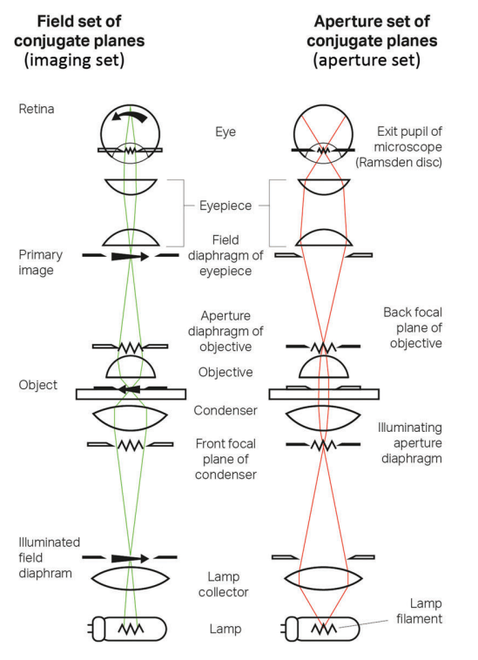
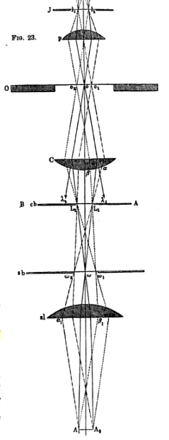
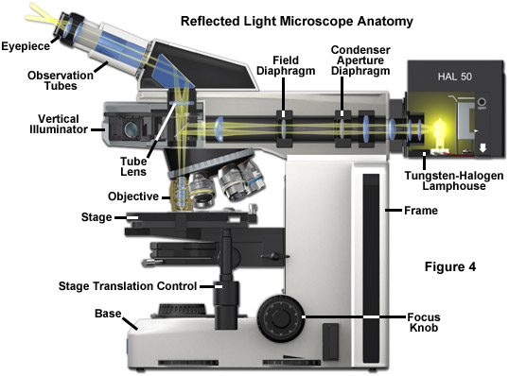
… to this!
Components of an Optical Microscope
http://zeiss-campus.magnet.fsu.edu/index.html
https://myscope.training/LFM_simulator.html

Slide 4
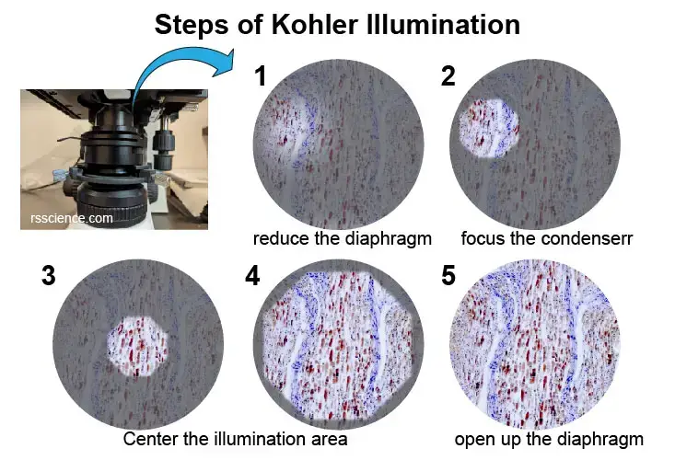
Components of an Optical Microscope
http://zeiss-campus.magnet.fsu.edu/index.html
https://myscope.training/LFM_simulator.html

Slide 5
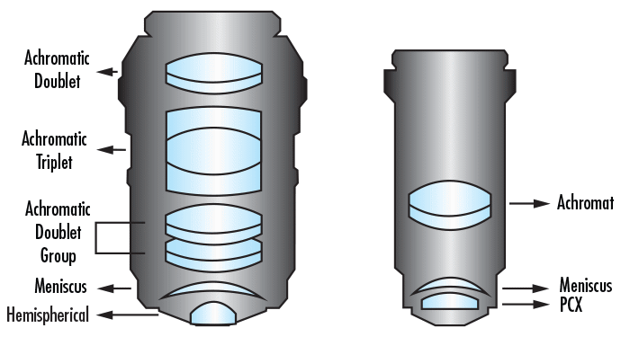
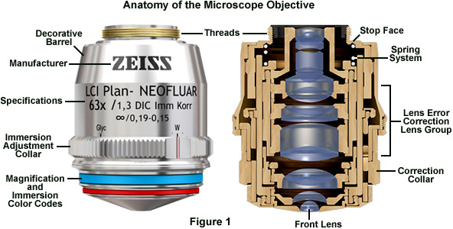
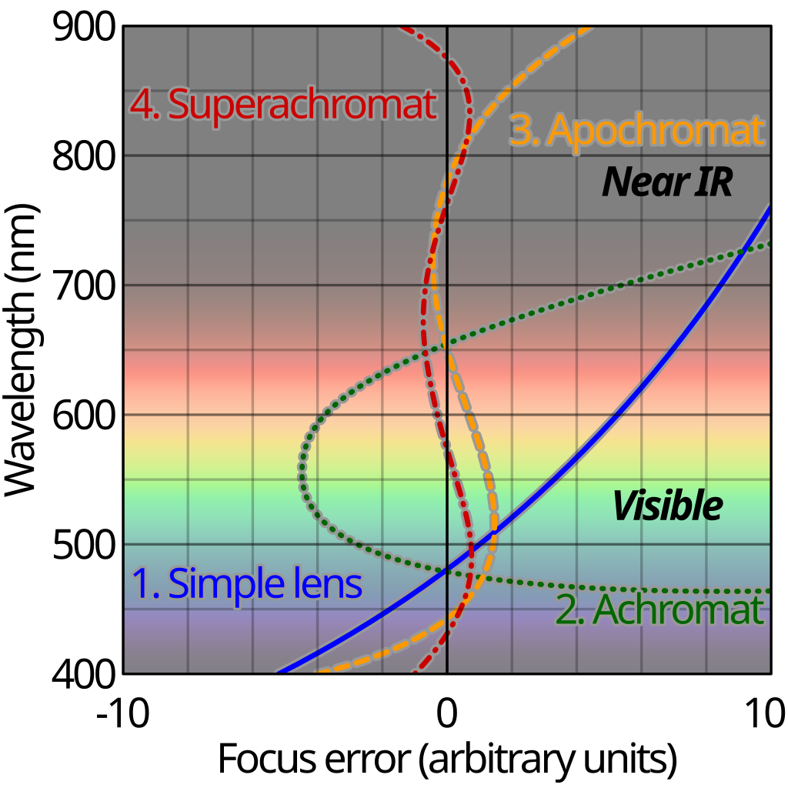
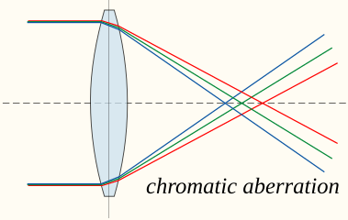
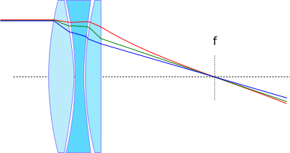
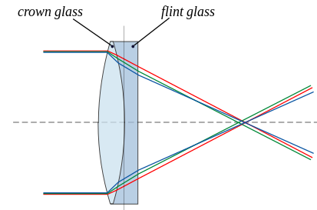
Components of an Optical Microscope
Apochromatic Achromatic
http://zeiss-campus.magnet.fsu.edu/index.html
https://myscope.training/LFM_simulator.html

Slide 6
Components of an Optical Microscope
Brightfield illumination – “standard” techniques; contrast by variation in absorption or refraction of light
Darkfield illumination – diffracted or refracted light
Differential interference contrast (DIC) – plane-polarized light; varying refractive indices can be distinguished by interference (also known as Nomarski microscopy)
Hoffman modulation –phase shifts; similar to DIC, but without the use of polarized light
Polarized light – plane-polarized light; variation in the polarization plane is detected by birefringence
Phase contrast – phase shift for materials with varying refractive indices
http://zeiss-campus.magnet.fsu.edu/index.html
https://myscope.training/LFM_simulator.html

Slide 7
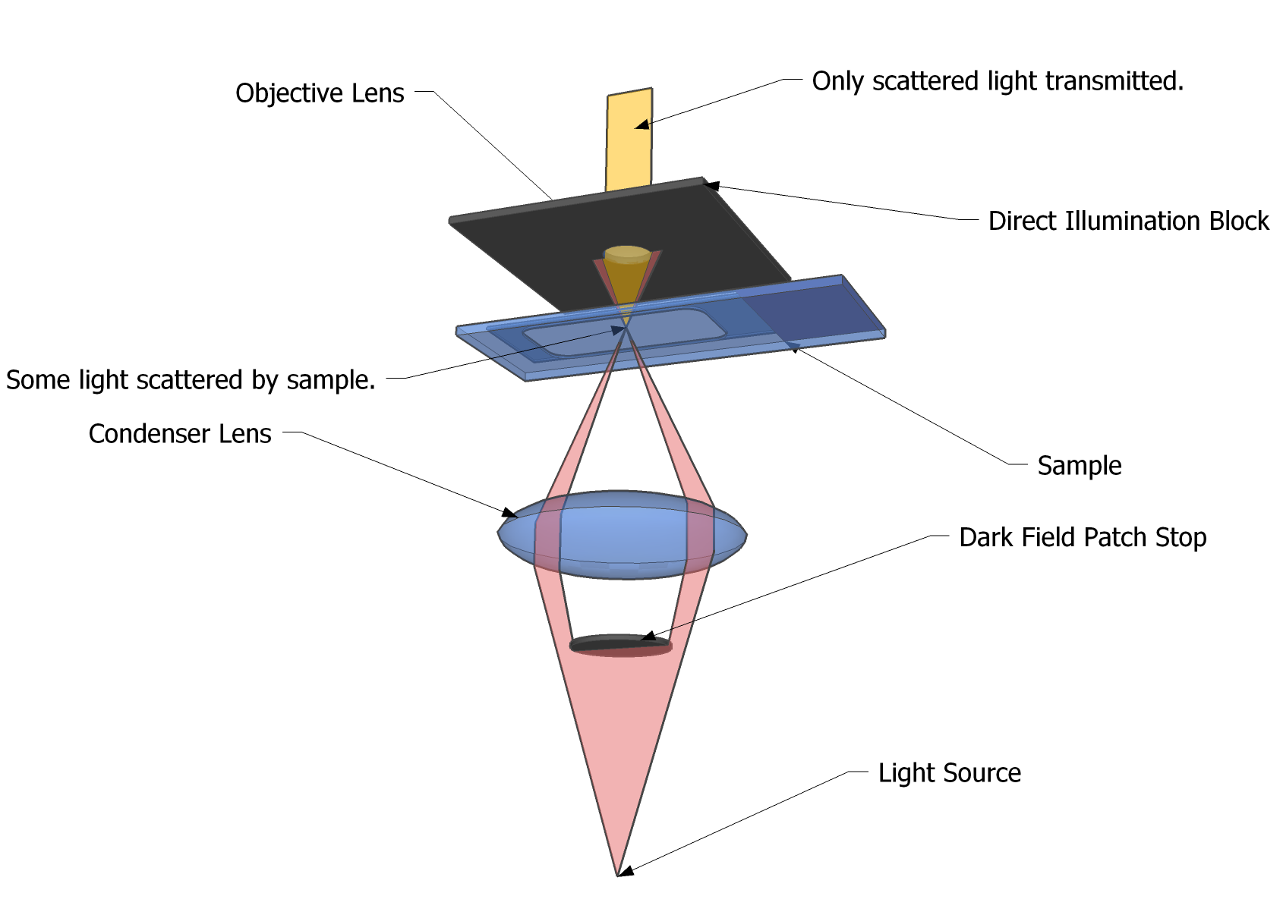
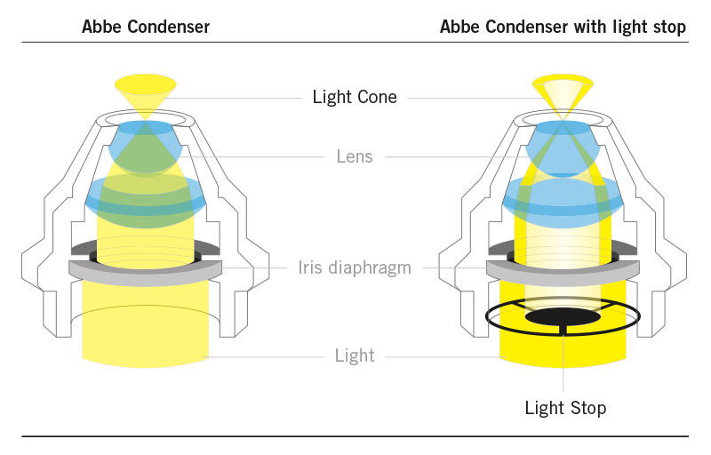
Dark Field Microscopy
Increasing contrast by removing background illumination.
By Richard Wheeler (Zephyris) 2006, CC-By 3.0

Slide 8
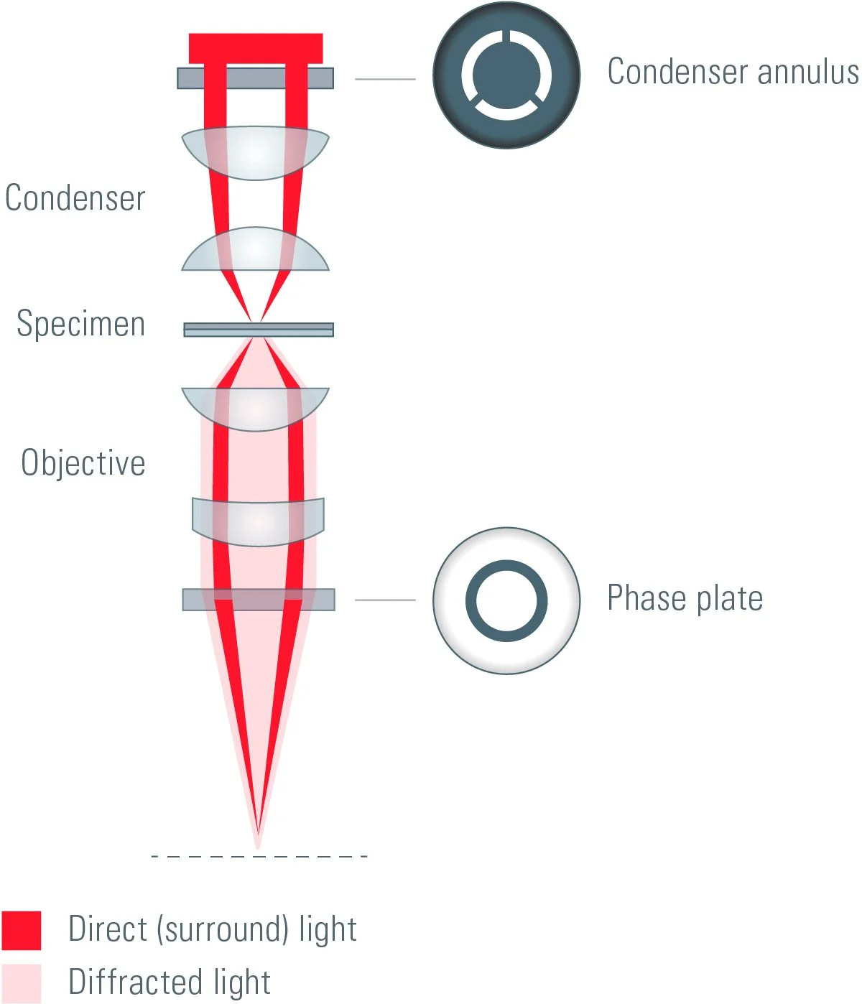
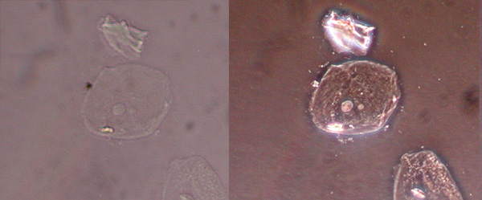
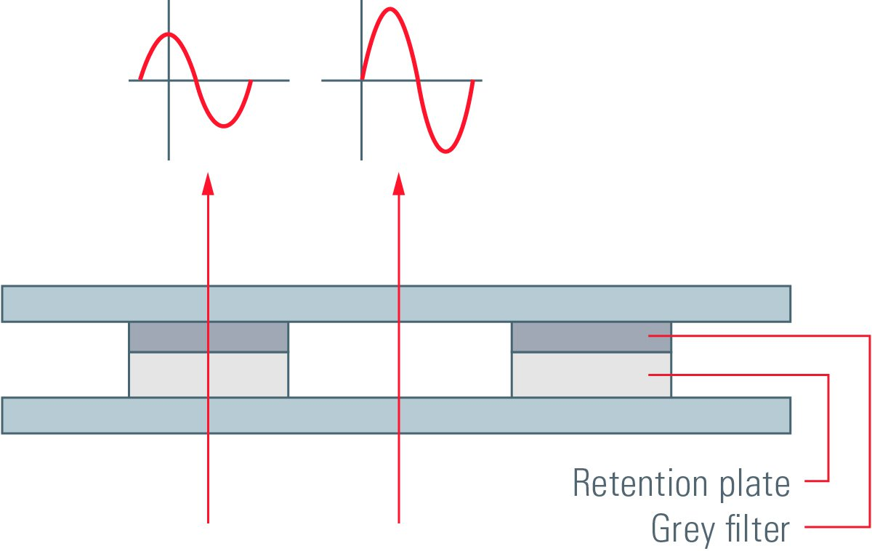
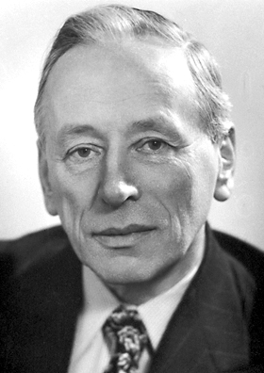
Phase Contrast Microscopy
Nobel Prize in Chemistry 1953
for his demonstration of the phase contrast method, especially for his invention of the phase contrast microscope.
Frits Zernike
Bright-field
Phase contrast
Interference between unscattered and scattered light is detected
Increased intensity when unscattered light has a phase shift of π/2
1888-1966

Slide 9
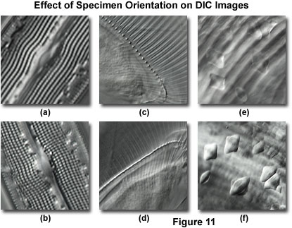
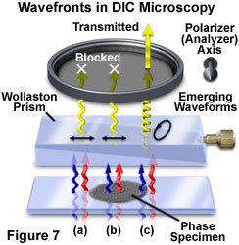
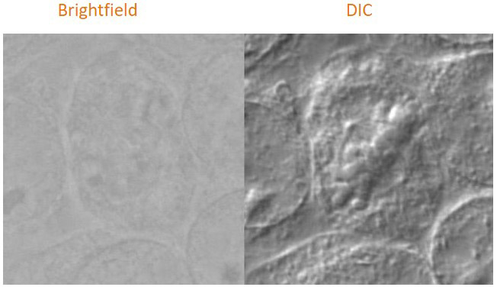
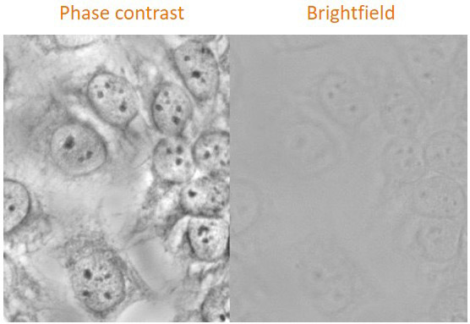
Differential Interference Contrast (DIC)
Shear axis
= orientation of the prism
Sample orientation towards shear axis is crucial !!!
90 °
https://www.olympus-lifescience.com/
Living cells
imaged in different modes
https://andor.oxinst.com/learning/

Slide 10
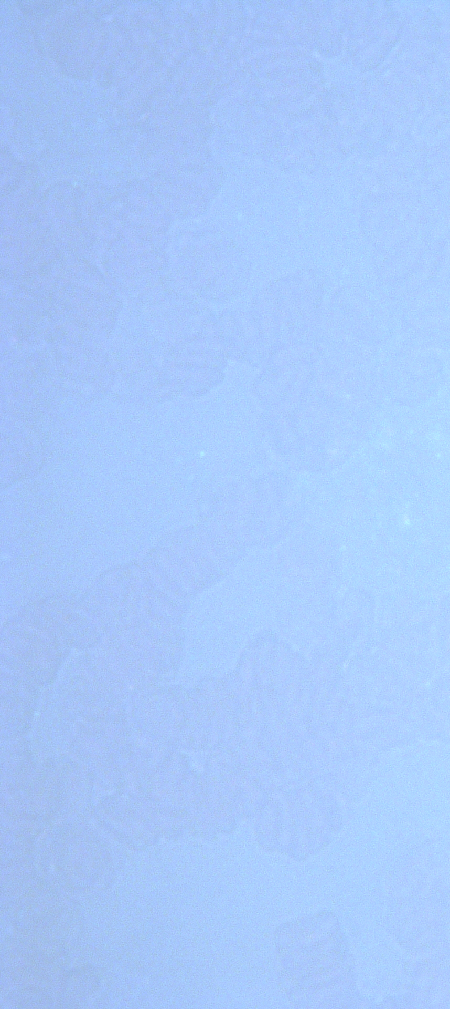
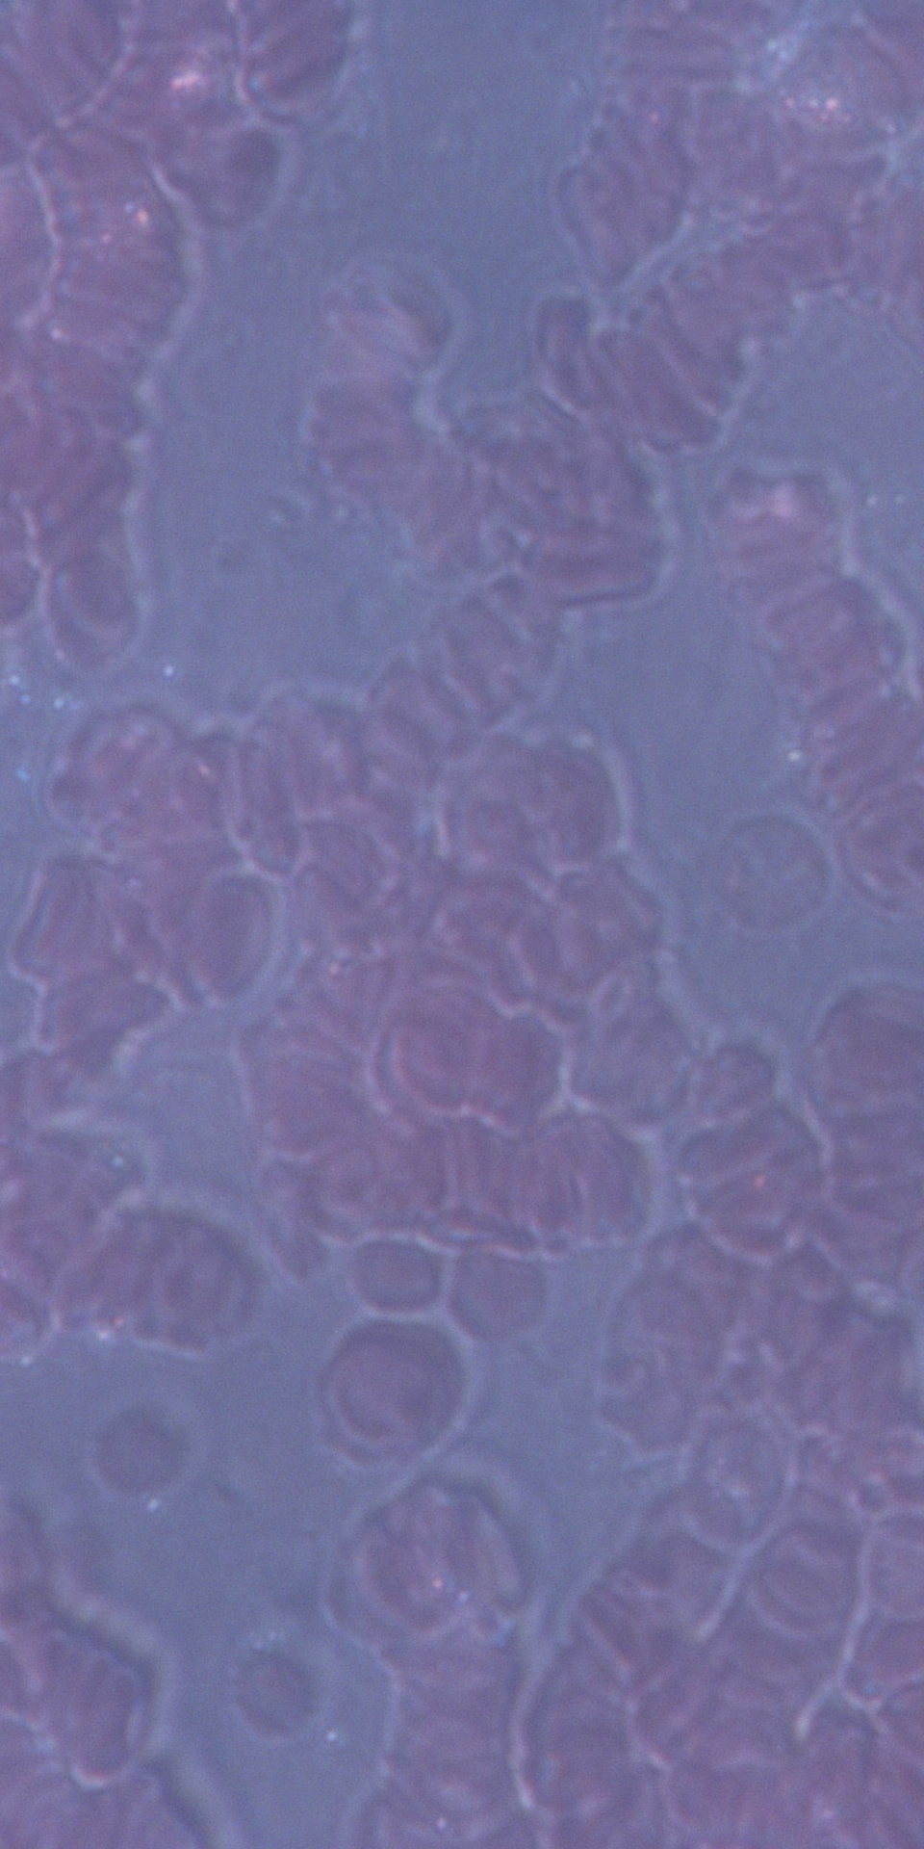
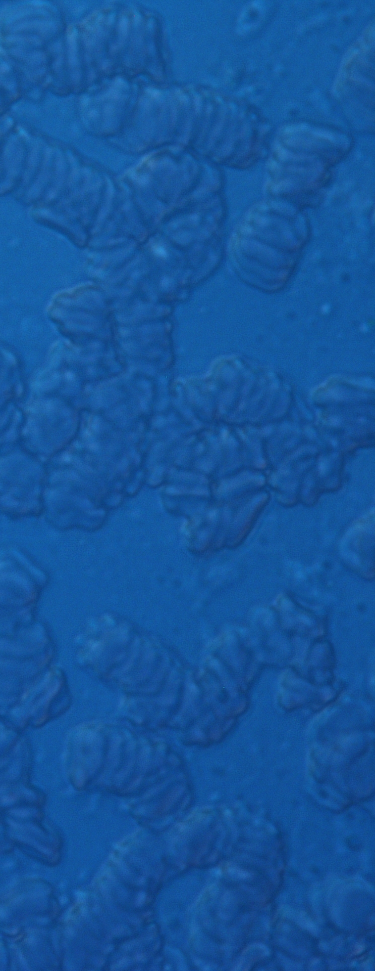
BF DF DIC

Slide 11
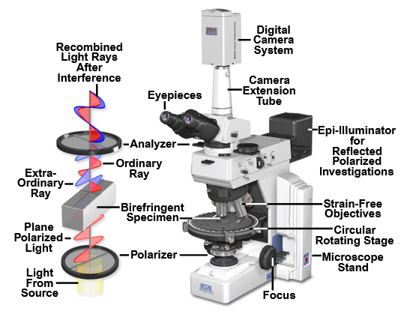
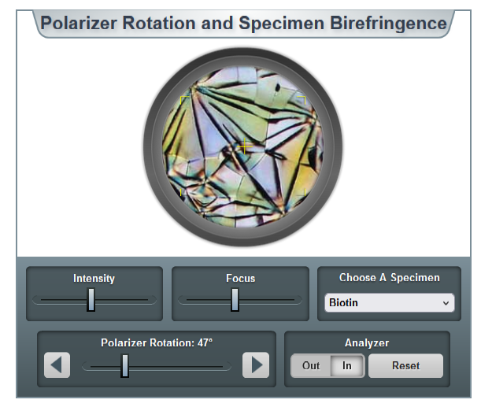
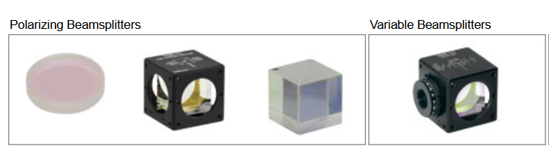
Polarized Light Microscopy
www.microscopyu.com/techniques/polarized-light/polarized-light-microscopy
two polarizing filters before/after the sample
www.thorlabs.com

Slide 12
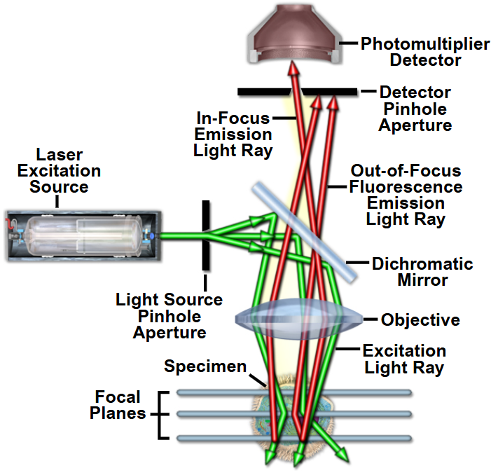
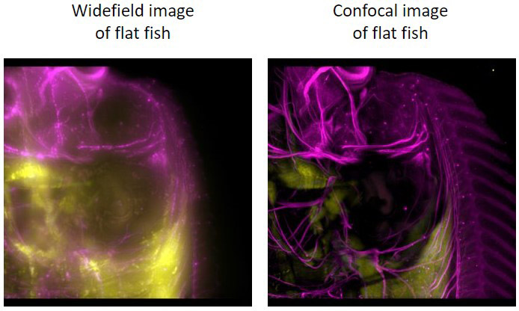
Widefield vs. Confocal
Microscopy
https://andor.oxinst.com/learning/
The confocal setup increases resolution a little
Out of focus light is filtered enhanced contrast

Slide 13
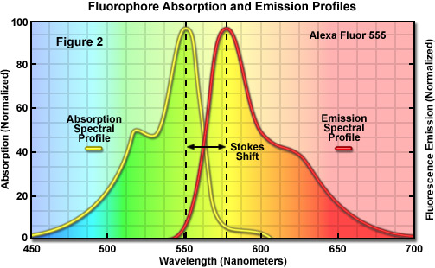
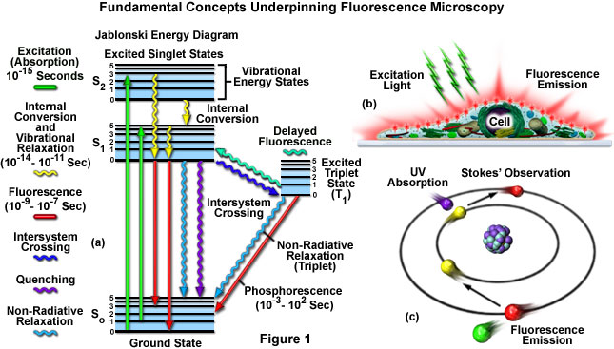
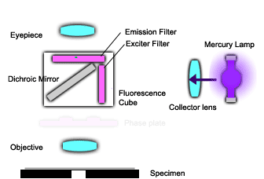
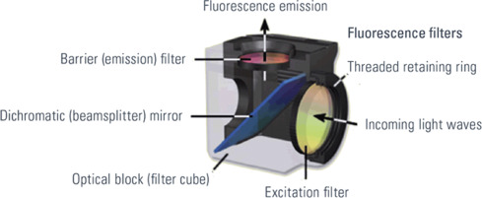
Fluorescence Microscopy
http://zeiss-campus.magnet.fsu.edu/index.html
https://vip.wartburg.edu/

Slide 14
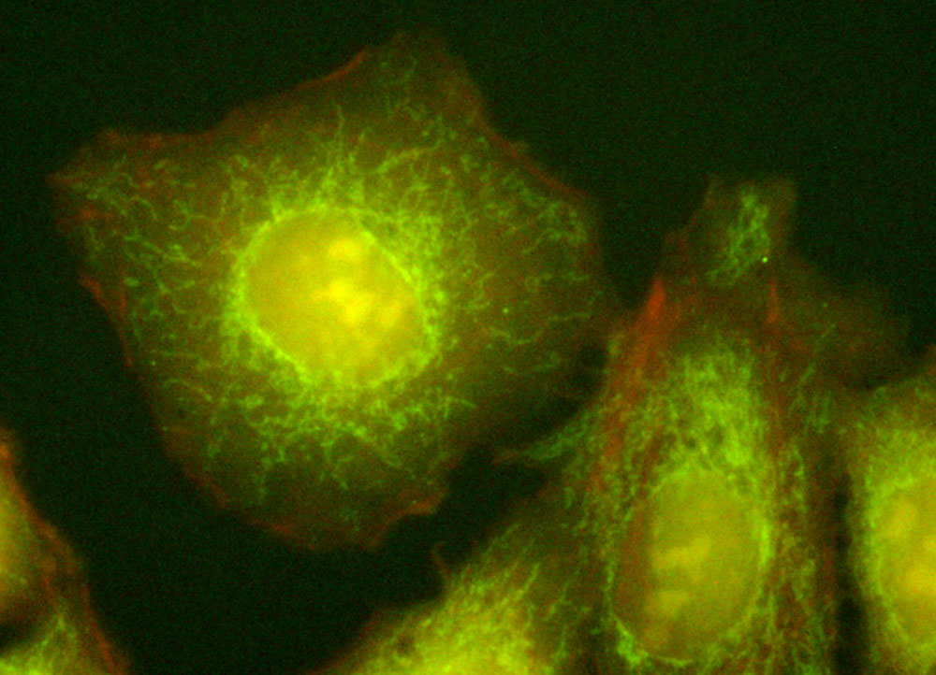
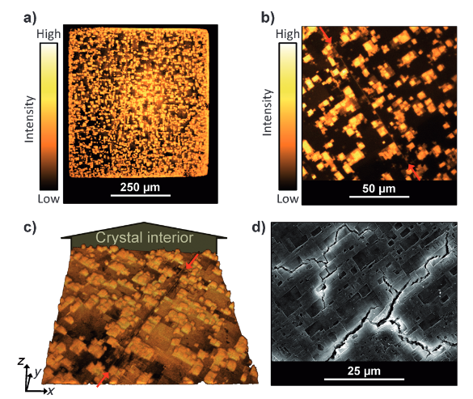
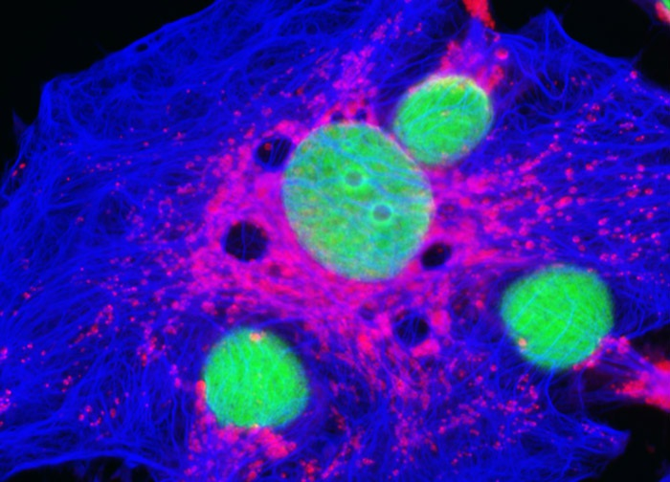
Examples of Fluorescence Microscopy
HeLa Cell Mitochondria
Defects in MOFs
Human Lung Carcinoma Cells
SEM
https://www.microscopyu.com/gallery-images/
Ameloot et al. Angew. Chem. Int. Ed. 2013, 52, 401 –405.

Slide 15
Examples of Fluorescence Microscopy
Defects in MOFs
SEM
Confocal fluorescence images of HKUST-1 single crystals
demonstrating the introduction of defects upon extending crystallization time.
Confocal fluorescence imaging of defects in a MOF-5 single
crystal. The red arrows indicate a line defect.
Ameloot et al. Angew. Chem. Int. Ed. 2013, 52, 401 –405.

Slide 16
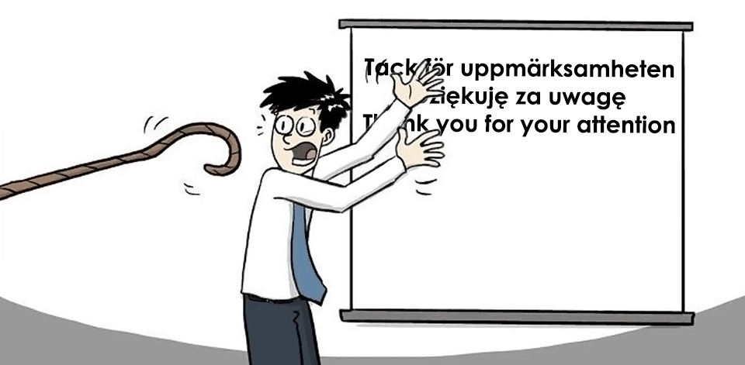
Contact:
Martin Jönsson-Niedziółka
email: martinj@ichf.edu.pl
Twitter: @DrMartinJN

